Slide 1
NLP

Slide 2
Introduction to NLP
Evaluation of Dependency Parsing

Slide 4
Evaluation of Dependency Parsing
Attachment Score (Buchholz & Marsi 2006)
# correct deps/# deps (attached to the right head)
Unlabeled dependency accuracy (UAS)
Labeled dependency accuracy (LAS)
1 Unionized Unionized VBN VBN - 2 NMOD - -
2 workers workers NNS NNS - 3 SBJ - -
3 are are VBP VBP - 0 ROOT - -
4 usually usually RB RB - 3 TMP - -
5 better better RBR RBR - 4 ADV - -
6 paid paid VBN VBN - 5 AMOD - -
7 than than IN IN - 5 AMOD - -
8 their their PRP$ PRP$ - 10 NMOD - -
9 non-union non-union JJ JJ - 10 NMOD - -
10 counterparts counterparts NNS NNS - 7 PMOD - -

Slide 5
Complexity
Projective (CKY) O(n⁵)
Projective (Eisner) O(n³)
Non-projective (MST - Chu-Liu-Edmonds) O(n²)
Projective (Malt) O(n)

Slide 6
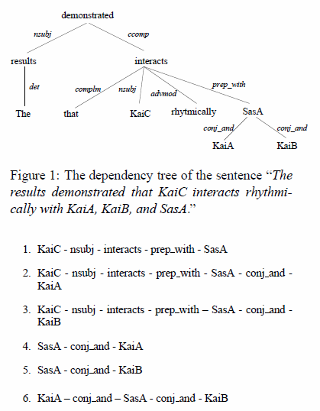
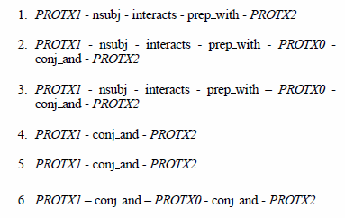
Use in Information Extraction
[Erkan et al. 2007]

Slide 7
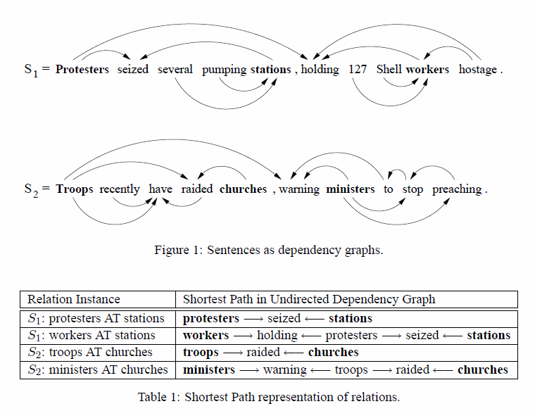
Dependency Kernels
[Bunescu and Mooney 2005]

Slide 8
External Links
http://ilk.uvt.nl/conll/
CONLL-X Shared task
http://ufal.mff.cuni.cz/pdt2.0/
Prague Dependency Treebank
http://nextens.uvt.nl/depparse-wiki/SharedTaskWebsite
http://nextens.uvt.nl/depparse-wiki/DataOverview
http://maltparser.org/
Joakim Nivre’s Maltparser
http://www.cs.ualberta.ca/~lindek/minipar.htm
Dekang Lin’s Minipar
http://www.link.cs.cmu.edu/link/
Daniel Sleator and Davy Temperley’s Link parser

Slide 9
Notes
The original versions of MSTParser and MaltParser from 2007 achieve about 81% accuracy
Highest in Japanese (91-92%)
Lowest in Arabic and Turkish (63-67%)
Non-projective parsing is harder than projective parsing

Slide 10
NLP

